Slide 1
Secure Data Hiding in Image Using Steganography
CAPSTONE PROJECT
Presented By: Om Rupeshbhai Mistry
Student Name : Om Rupeshbhai Mistry
College Name : Silver Oak College of Engineering & Technology
Department: Computer Science & Engineering (Cyber Security)

Slide 2
OUTLINE
Problem Statement
Technology used
Wow factor
End users
Result
Conclusion
Git-hub Link
Future scope

Slide 3
Problem Statement
This project develops a secure image steganography system using the Least Significant Bit (LSB) technique to hide encrypted text within images. It enhances security by integrating Fernet encryption, ensuring hidden data remains protected even if extracted. A user-friendly GUI-based tool enables easy encryption, embedding, extraction, and decryption. This approach strengthens covert communication and data privacy in cybersecurity applications.

Slide 4
Technology used
Programming Language: Python
Libraries: OpenCV (image processing), NumPy, Tkinter (GUI), Cryptography (Fernet encryption), Hashlib, Base64
Techniques: Least Significant Bit (LSB) Steganography, Symmetric Encryption
GUI Framework: Tkinter (for user-friendly interface)
Image Formats Supported: PNG, JPG, JPEG

Slide 5
Wow factors
Dual Security: Combines LSB steganography with Fernet encryption for enhanced protection.
Password-Based Encryption: Uses hash-derived keys for secure message encoding.
User-Friendly GUI: Simple Tkinter-based interface for seamless operation.
Scalability: Can be extended to other encryption methods and media types.
Robust Validation: Ensures error handling and key authentication to prevent unauthorized access.

Slide 6
End users
Cybersecurity Professionals: For secure data transmission and covert communication.
Forensic Investigators: To hide and retrieve sensitive case-related information.
Journalists & Activists: For secure communication in restricted environments.
Government & Intelligence Agencies: For confidential data exchange.
General Users: Anyone needing private, encrypted data storage within images.

Slide 7
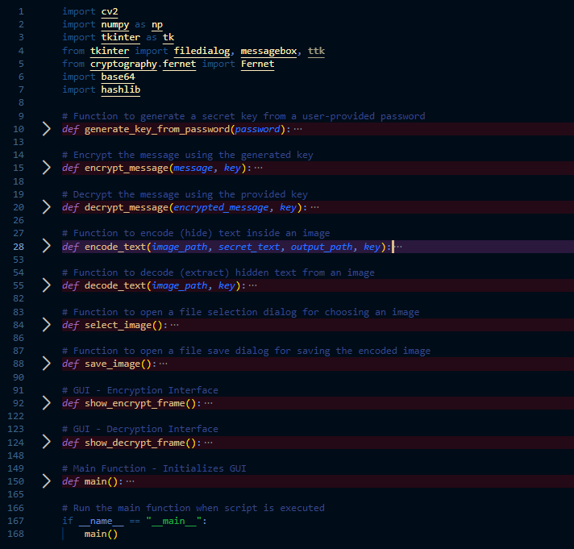
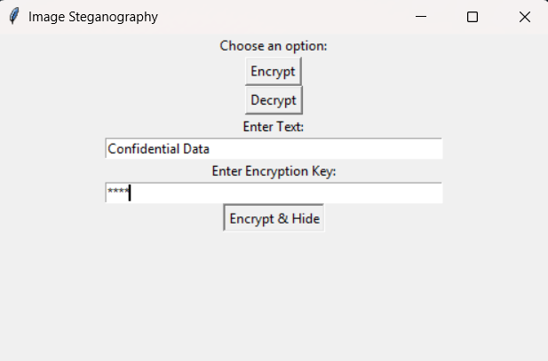
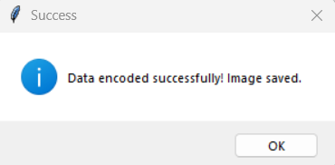
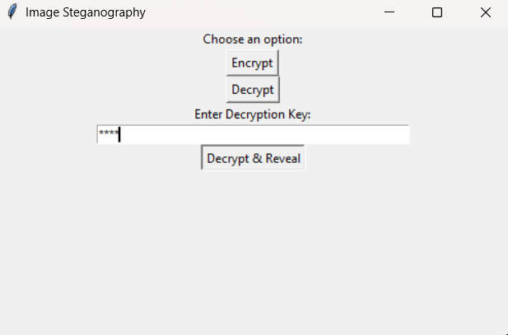
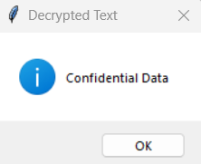
Results
Python Code
Encryption GUI
Data Encryption
Decryption GUI
Data Decryption

Slide 8
Conclusion
This project provides a secure and efficient steganography system by integrating LSB image hiding with Fernet encryption, ensuring both data confidentiality and covert communication. The user-friendly GUI simplifies encryption and decryption, making it accessible for various users, from cybersecurity professionals to general users. With scalability and future enhancements, this system has the potential to evolve into a robust, multi-platform security tool for secure data transmission.

Slide 9
GitHub Link
https://github.com/OMMISTRY197/Steganography.git

Slide 10
Future scope
Enhanced Encryption - Integrate AES or RSA encryption for stronger security.
Support for Other Media - Extend steganography to audio, video, and PDFs.
AI-Based Detection Prevention - Implement techniques to evade steganalysis attacks.
Cloud Integration - Enable secure cloud-based encoding and decoding.
Mobile & Web App Development - Develop cross-platform applications for wider accessibility.

Slide 11
THANK YOU

